Slide 1
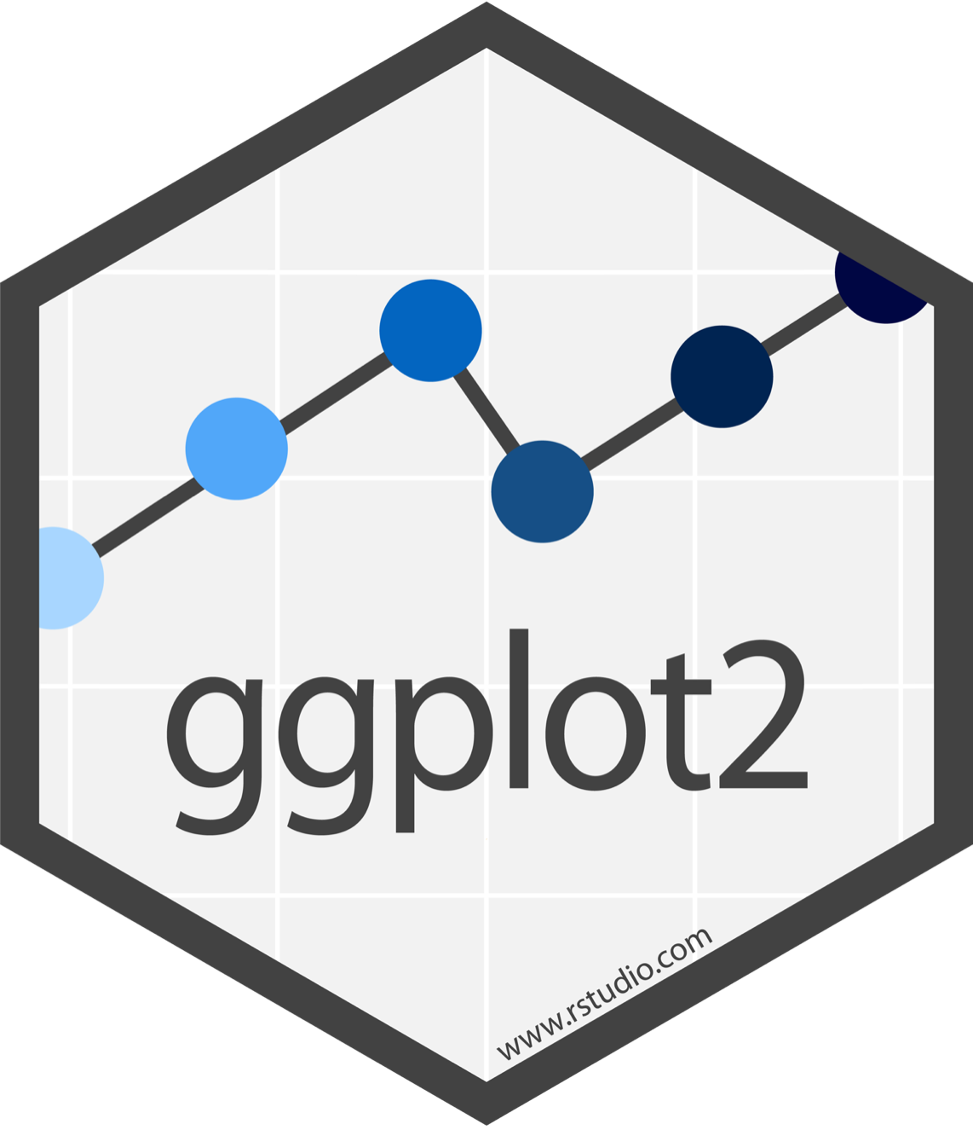
Visualize Data with

Slide 2
Visualize
Import
Tidy
Model
Reason
Communicate
Transform
Program
Notes:
We'll start with visualizing data. I need everyone to be able to visualize their data with confidence. This will make it easier to understand what we're doing when we start transforming data later in the workshop.

Slide 3
"The simple graph has brought more information to the data analyst’s mind than any other device. "
- John Tukey

Slide 4

Our dataset for much of today
NB: we ignore survey weights today – check my Youtube video on how to handle them

Slide 5
ess_mini
Some variables from the 2014 round to get started
ess_mini

Slide 6
Quiz
Confer with your partner / group.
What relationship do you expect to see between height and weight?
What chart would you like to see?
No peeking ahead!
01:00
6

Slide 7
Your Turn 1
Run this code in 02-Visualize-Exercises.Rmd to make a graph. Ensure that the setup chunk loads the data. Pay strict attention to spelling, capitalization, and parentheses!
ggplot(data = ess_mini) +
geom_point(mapping = aes(x = height, y = weight))
03:00
7

Slide 8
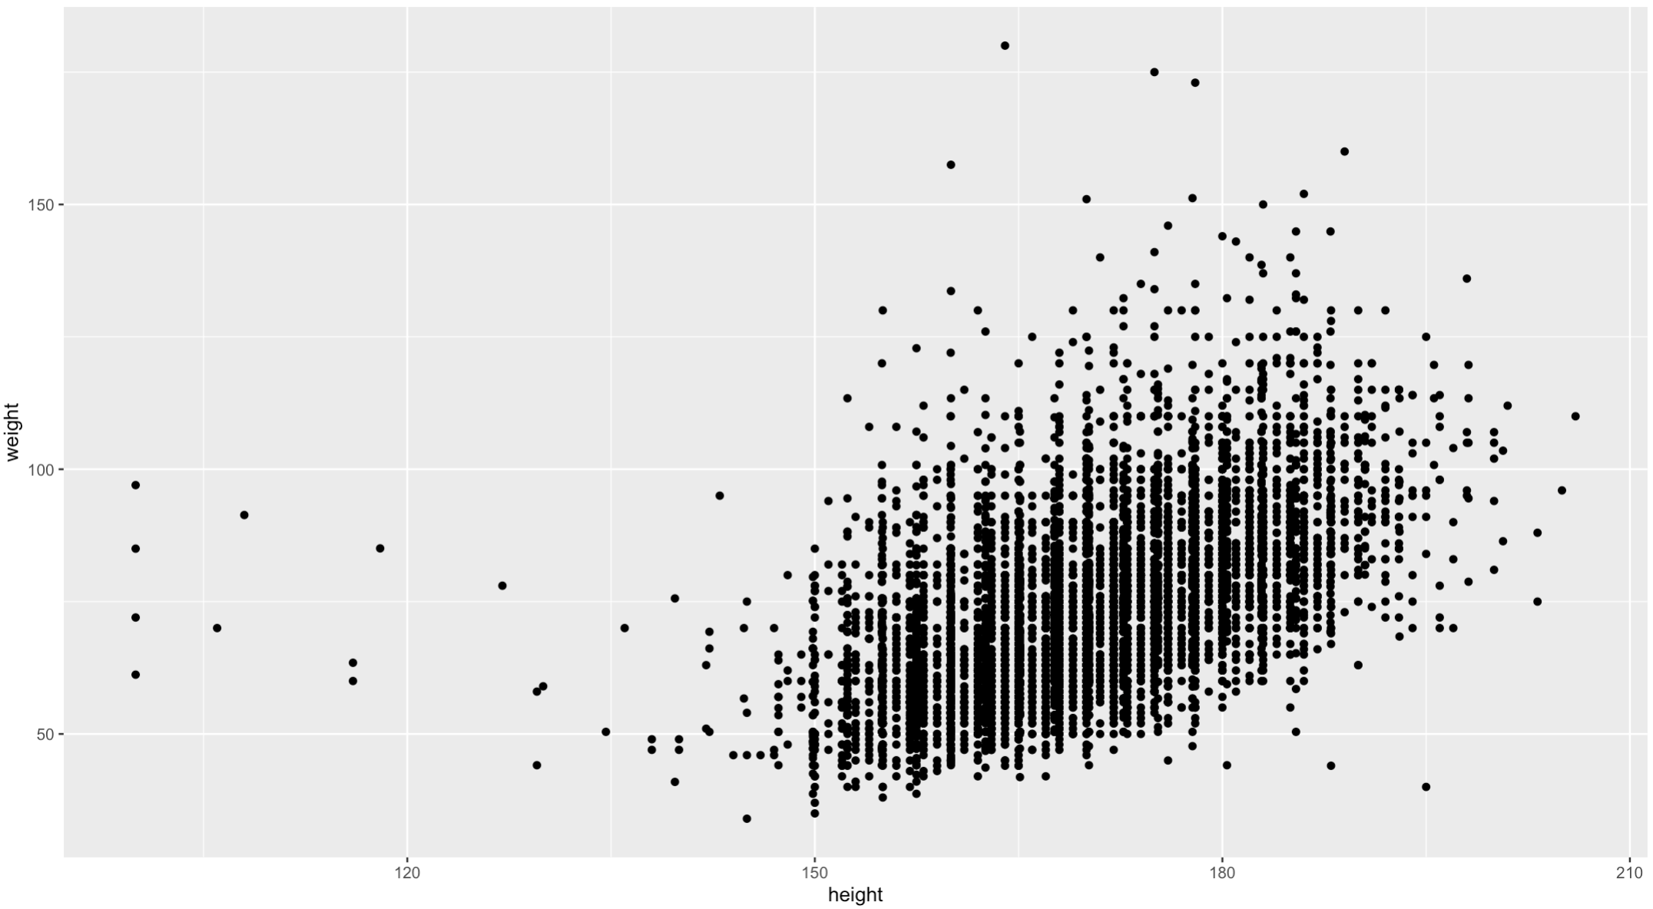
ggplot(data = ess_mini) +
geom_point(mapping = aes(x = height, y = weight))

Slide 9
"Initialize" a plot with ggplot()
Add layers with geom_ functions
ggplot(data = ess_mini_UK) +
geom_point(mapping =
aes(x = height, y = weight))
9

Slide 10
Trap 1: Always put the + at the end of a line, never at the start
ggplot(data = ess_mini) +
geom_point(mapping = aes(x = height, y = weight))
Trap 2: Two closing brackets (always need to match)
10

Slide 11
ggplot(data = ess_mini_UK) +
geom_point(mapping = aes(x = height, y = weight))
Mapping: link aesthetic elements with variables, inside aes() function
11

Slide 12
A template
ggplot(data = <DATA>) +
<GEOM_FUNCTION>(mapping = aes(<MAPPINGS>))
ggplot(data = ess_mini_UK) +
geom_point(mapping = aes(x = height,
y = weight))

Slide 13

Mappings

Slide 14
A bivariate relationship is interesting – but we can do better …

Slide 15
Aesthetics
Visual Space
Data Space
color
gndr
ggplot(data = ess_mini) +
geom_point(mapping = aes(x = height, y = weight, <MORE>))
E.g., shape = gndr
aesthetic property
Variable to map to it
15

Slide 16
Your Turn 2
In the next chunk, add color, size, alpha, and shape aesthetics to your graph. Experiment.
Click on ess_mini in Environment to see what data is available.
Do different things happen when you map aesthetics to discrete and continuous variables?
05:00
16

Slide 17
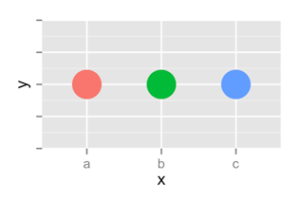
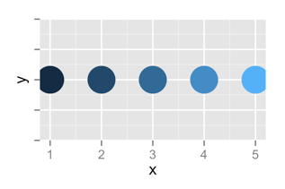
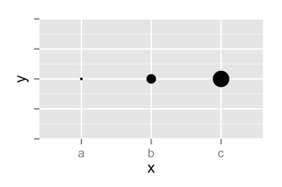
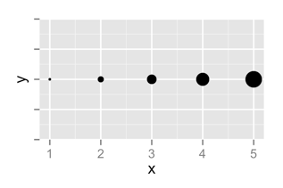
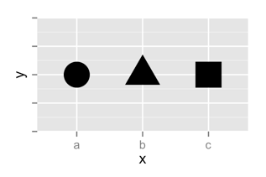
 | Discrete | Continuous
Color
Size
Shape
17

Slide 18
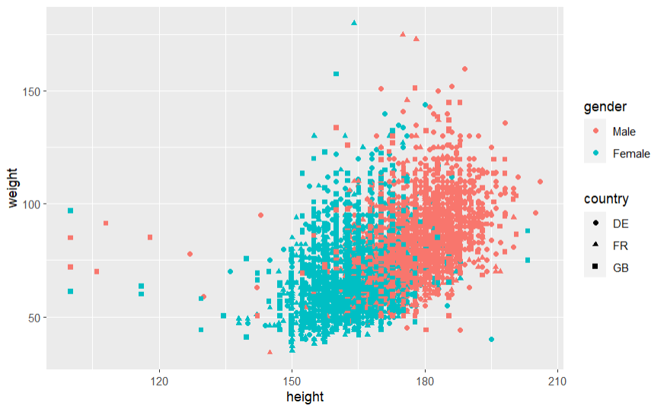
Legends added automatically
ggplot(data = ess_mini) +
geom_point(mapping = aes(x = height, y = weight,
color = gender, shape = country))

Slide 19
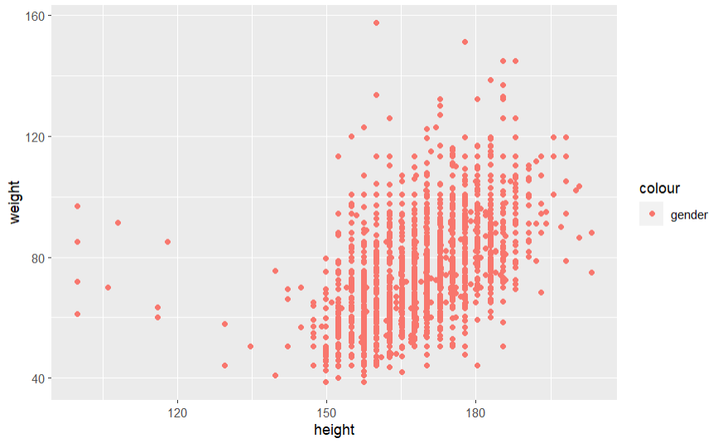
Meaningless!
ggplot(data = ess_mini_UK) +
geom_point(mapping = aes(x = height, y = weight, color = “gender”))

Slide 20
Error!
ggplot(data = ess_mini_UK) +
geom_point(mapping = aes(x = height, y = weight), color = gender)
Possible if you just want to format the chart:
ggplot(data = ess_mini_UK) +
geom_point(mapping = aes(x = height, y = weight), color = "pink")

Slide 21
Facets

Slide 22
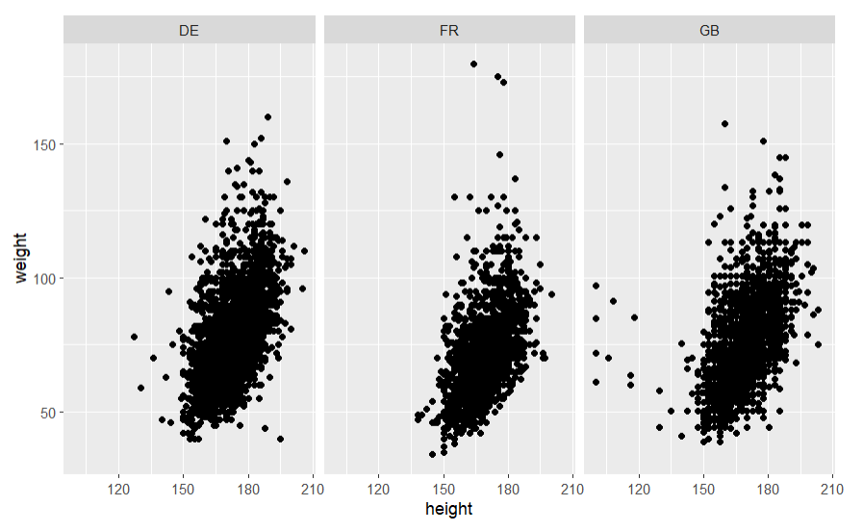
Facets
Subplots that display subsets of the data.

Slide 23
Have a look
What do facet_grid and facet_wrap do?
p <- ggplot(data = ess_mini) +
geom_point(mapping = aes(x = height, y = weight))
p + <ADDITIONS>
Run the code and explore outputs
02:00
23
Notes:
We can save the plot to an object, and then process it further.

Slide 24
A ggplot2 template
Make any plot by filling in the parameters of this template
ggplot(data = <DATA>) +
<GEOM_FUNCTION>(mapping = aes(<MAPPINGS>)) +
<FACET_FUNCTION>
24

Slide 25
Geoms

Slide 26
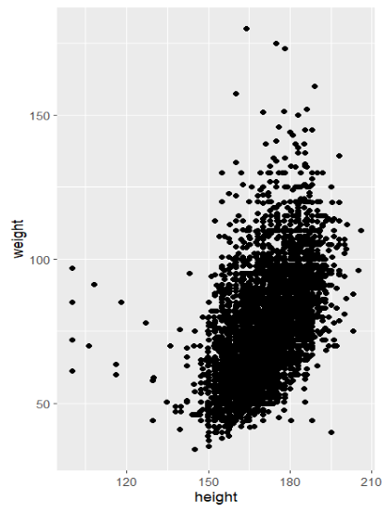
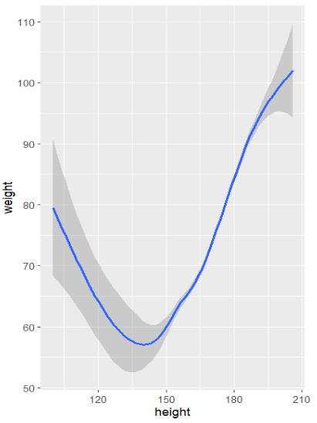
How are these plots similar?
Same:
x var
, y var
, data

Slide 27
How are these plots different?
Different: geometric object (geom),
i.e. the visual object used to represent the data

Slide 28
geoms
ggplot(data = <DATA>) +
<GEOM_FUNCTION>(mapping = aes(<MAPPINGS>))
28

Slide 29
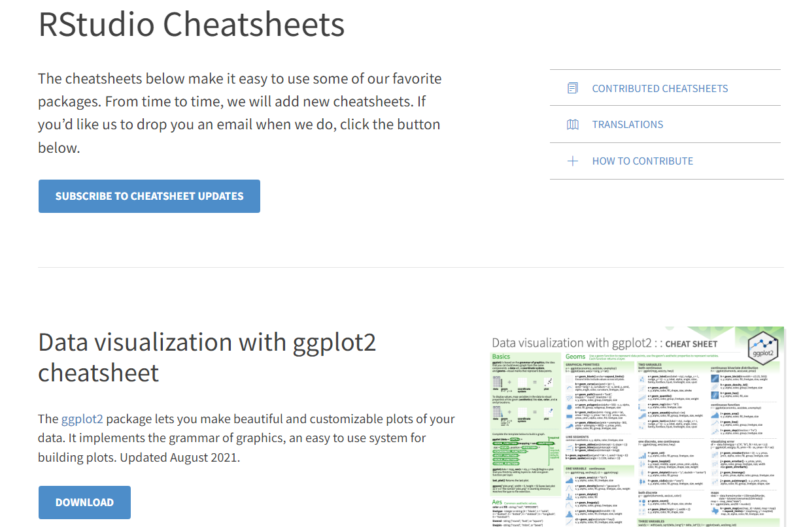
https://posit.co/resources/cheatsheets/
Most important ones (including ggplot2) are also in your workshop materials
(./cheatsheets)

Slide 30
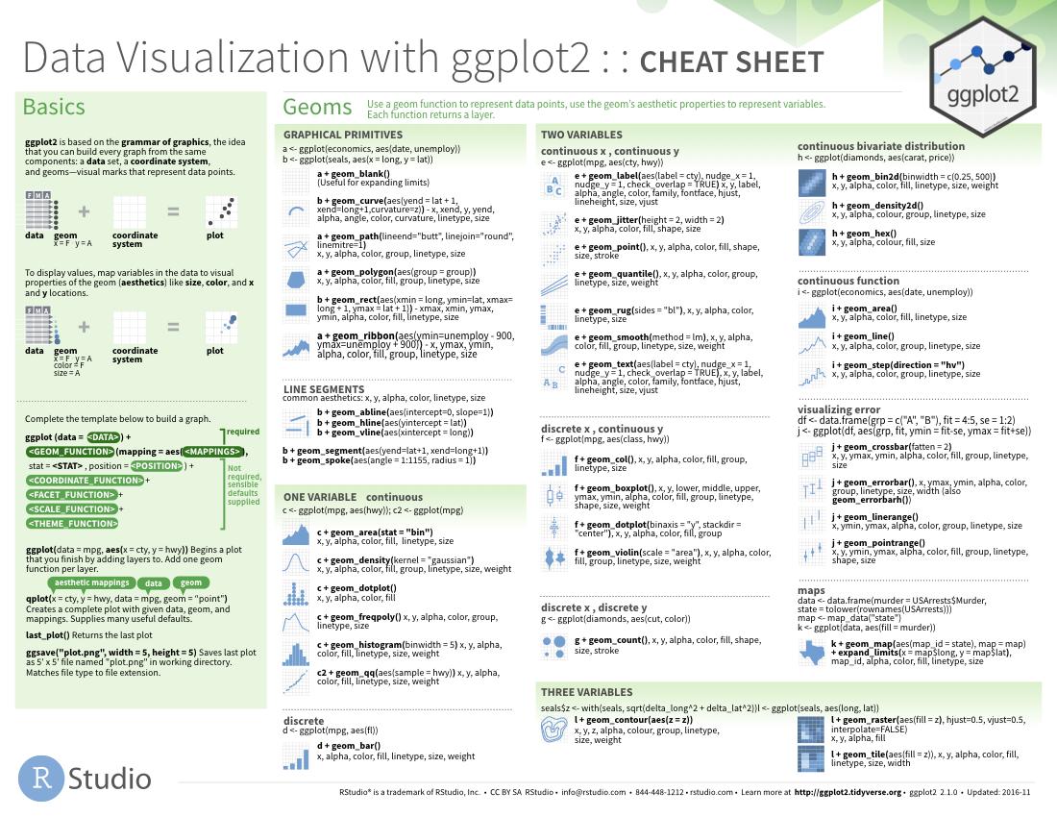
geom_ functions
Each requires a mapping argument and accepts different aesthetics.

Slide 31
Your Turn
Pair up.
31

Slide 32
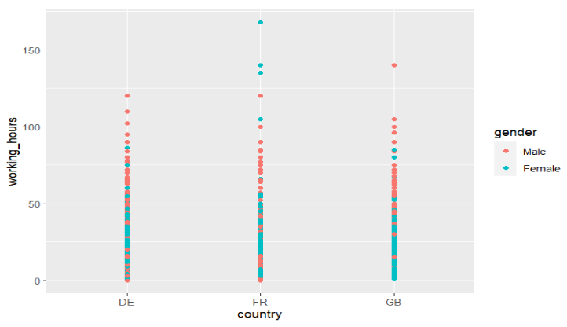
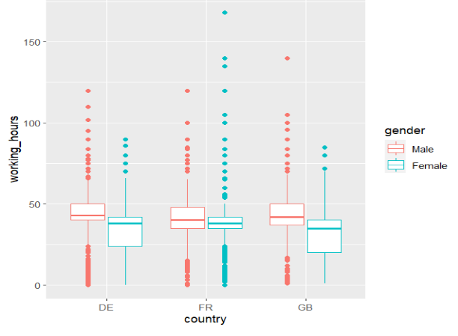
Your Turn 3
With your partner, decide how to replace this scatterplot with boxplots. Use the cheat sheet and/or try your best guess.
ggplot(data = ess_mini) +
geom_point(mapping = aes(country, working_hours,
color = gender))
02:00

Slide 33
Changing the geom can be very simple
ggplot(data = ess_mini) +
geom_boxplot(mapping = aes(country, working_hours,
color = gender))

Slide 34
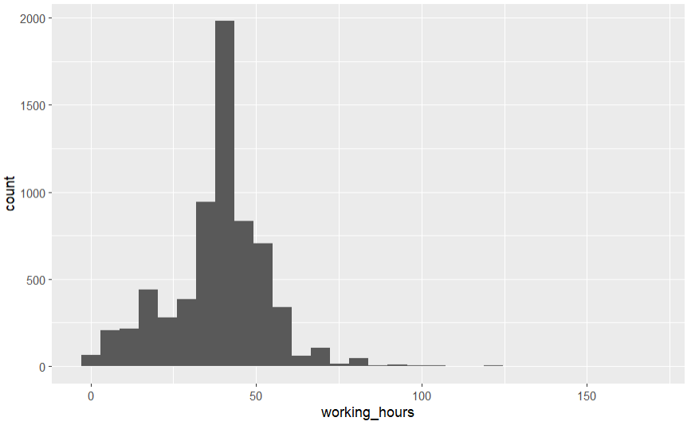
Your Turn 4
With a partner, make the histogram of working hours below. Use the cheat sheet. Hint: do not supply a y variable.
Bonus: facet by country.
02:00

Slide 35
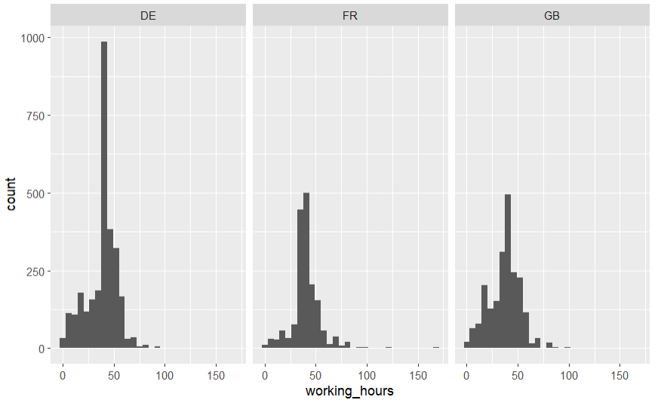
ggplot(ess_mini) +
geom_histogram(aes(x = working_hours)) +
facet_wrap(vars(country))

Slide 36
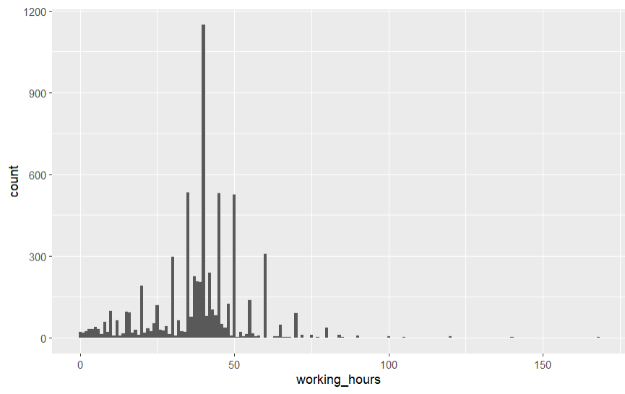
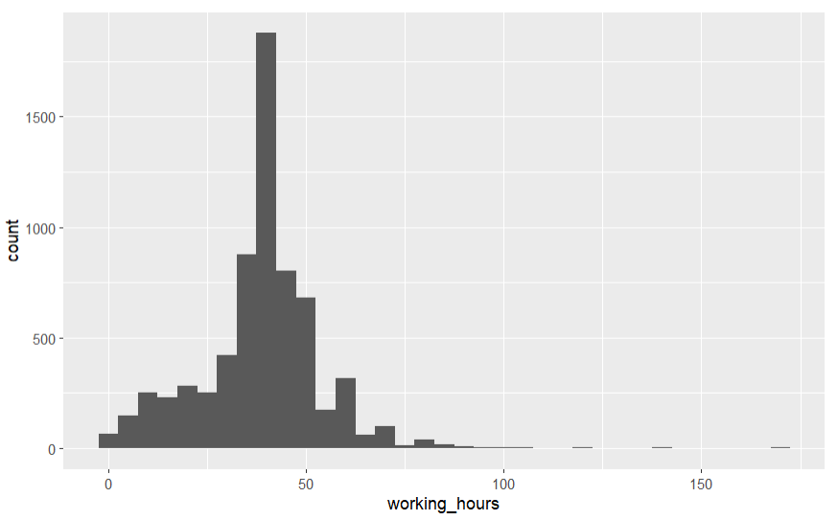
Quiz
What is the difference?
36

Slide 37
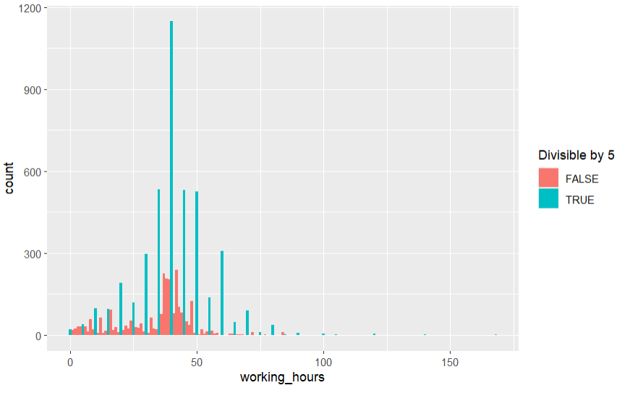
Why the spikes?
37
Notes:
ggplot(ess_mini) +
geom_histogram(aes(x = working_hours, fill = working_hours %% 5 == 0), binwidth = 1) +
labs(fill = "Divisible by 5")

Slide 38
What can we do to better compare the shape of the distributions?
Notes:
ggplot(ess_mini) +
geom_histogram(aes(x = working_hours), binwidth = 5) +
facet_wrap(vars(country), scales = "free_y")

Slide 39
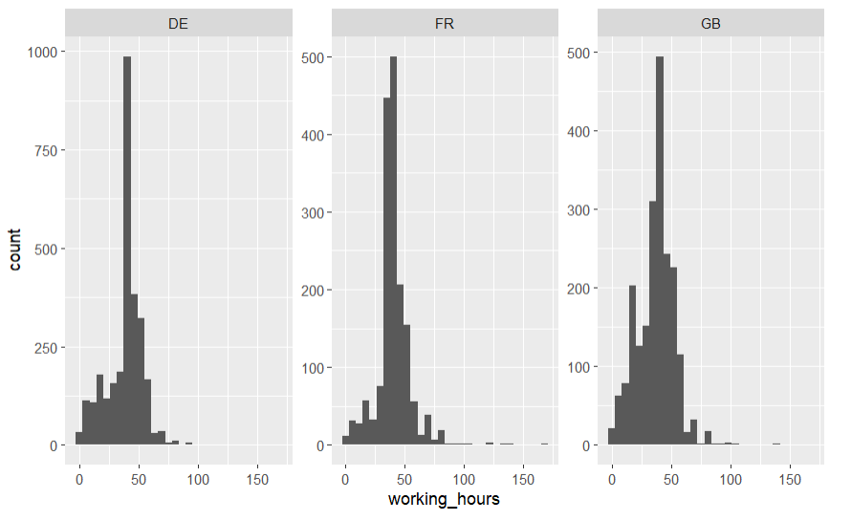
What can we do to better compare the shape of the distributions?
Notes:
To actually compare, probably better options that show all in one graph.

Slide 40
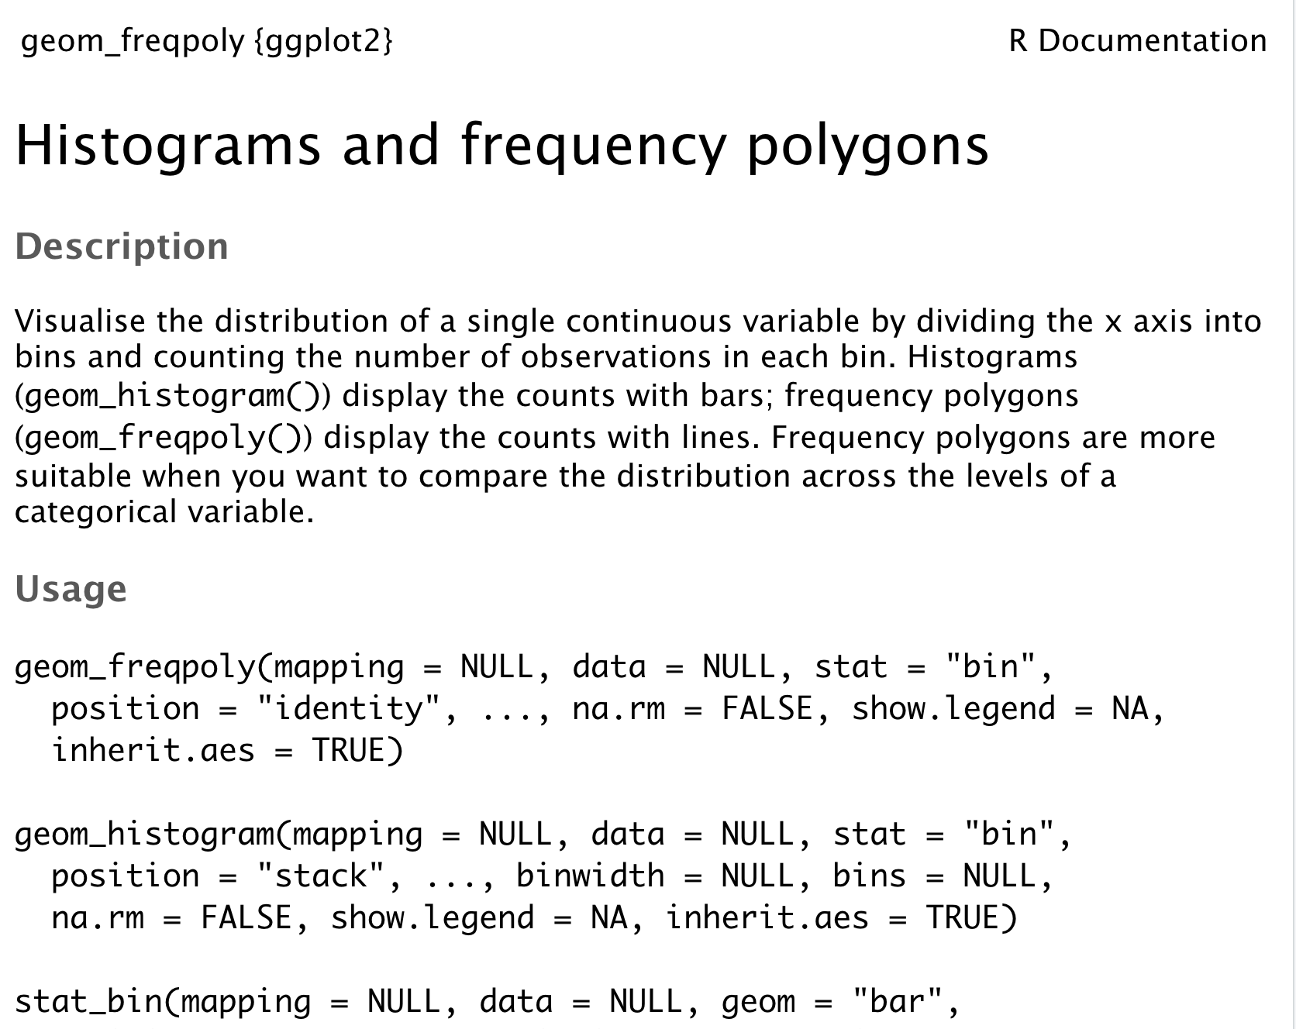
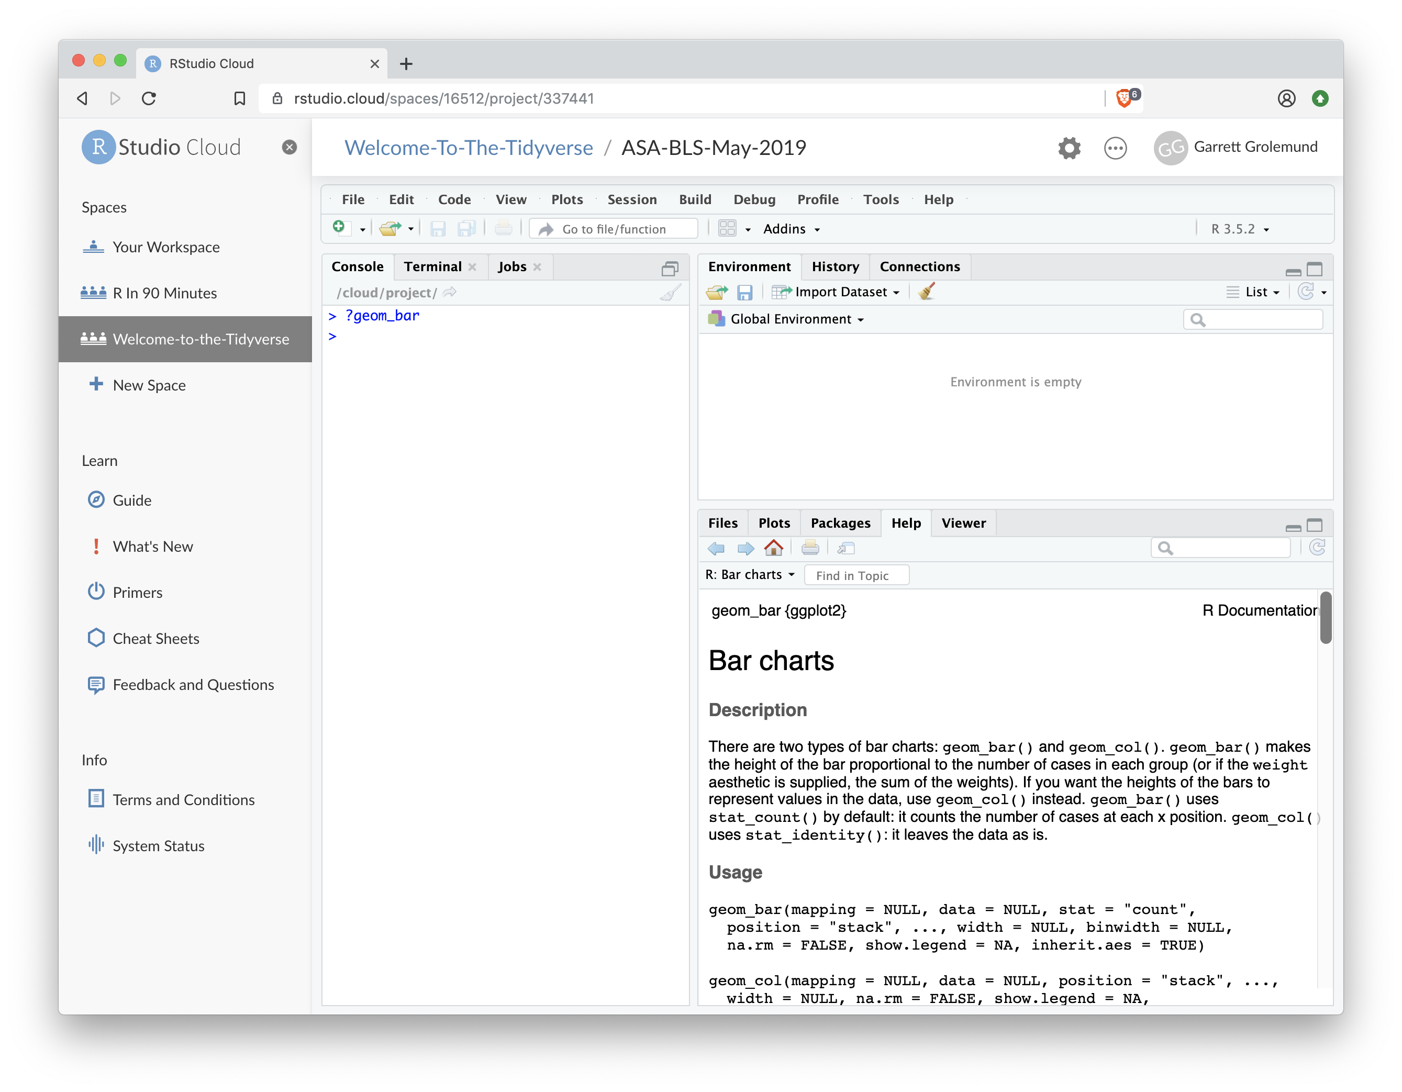
"Help" pages
To open the documentation for a function, type
?geom_histogram
?
function name (no parentheses)

Slide 41
Tips
scan page for relevant info
ignore things that don't make sense
try out the examples (at the very bottom)

Slide 42
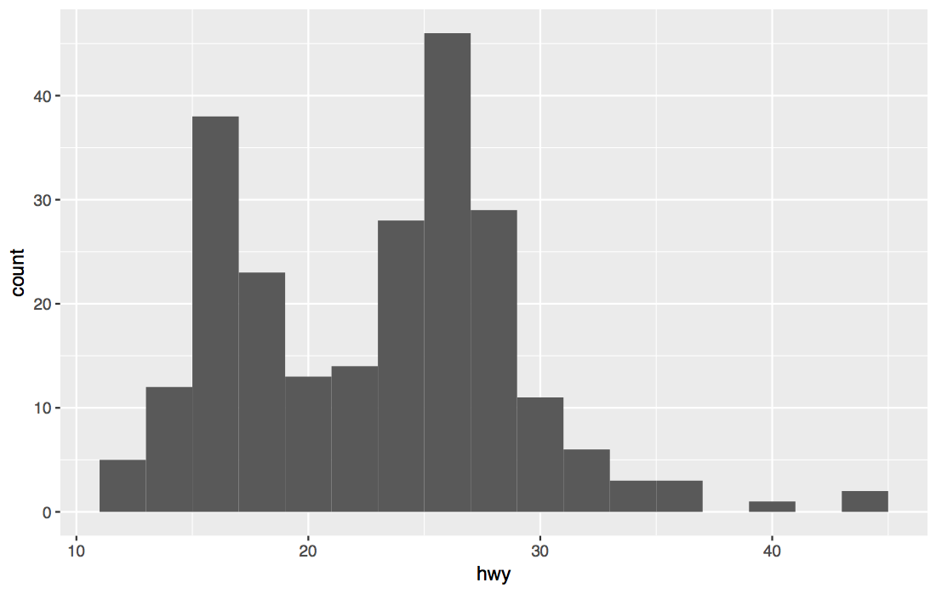
Your Turn 5
Use the help page for geom_histogram to make the bins 5 hours wide.
Bonus: “free” the y-axis scale in the facets
03:00

Slide 43
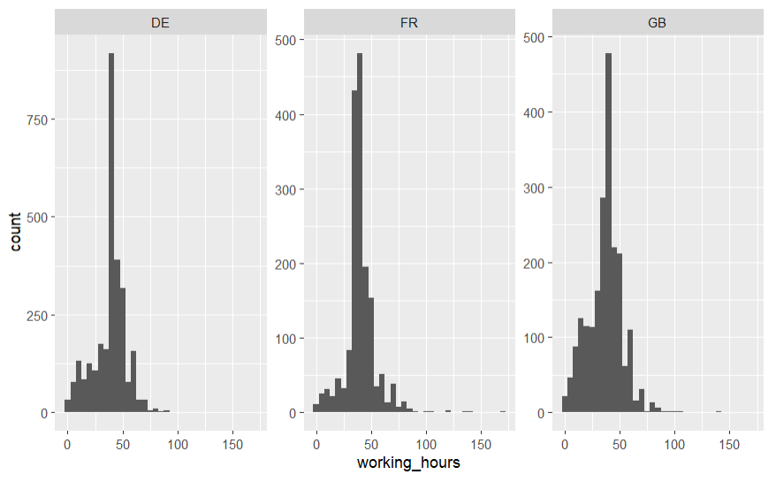
ggplot(ess_mini) +
geom_histogram(aes(x = working_hours), binwidth = 5) +
facet_wrap(vars(country), scales = "free_y")

Slide 44
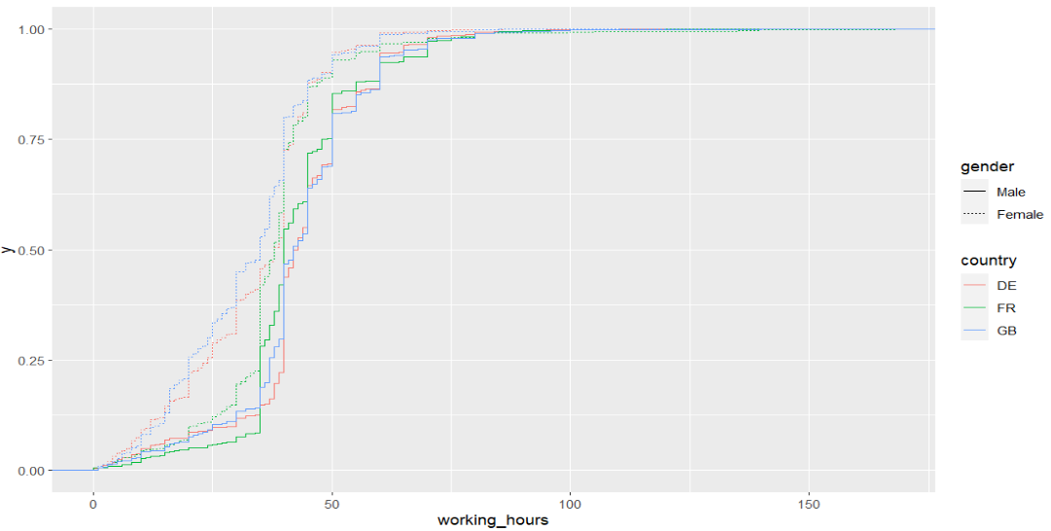
A worthy alternative – ECDF plots
ggplot(ess_mini) +
stat_ecdf(aes(y = main_activity, color = gender))

Slide 45
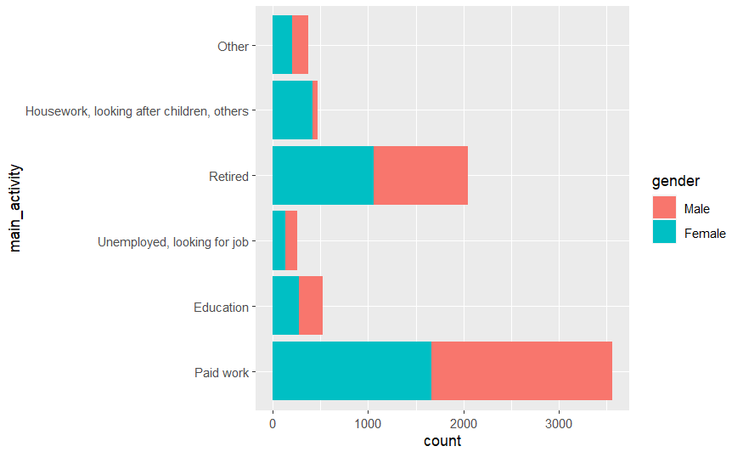
Your Turn 6
With a partner, make the bar chart of main_activity below. Hint: the cheat sheet lists available aesthetics. Hint: do not supply an x variable.
02:00

Slide 46
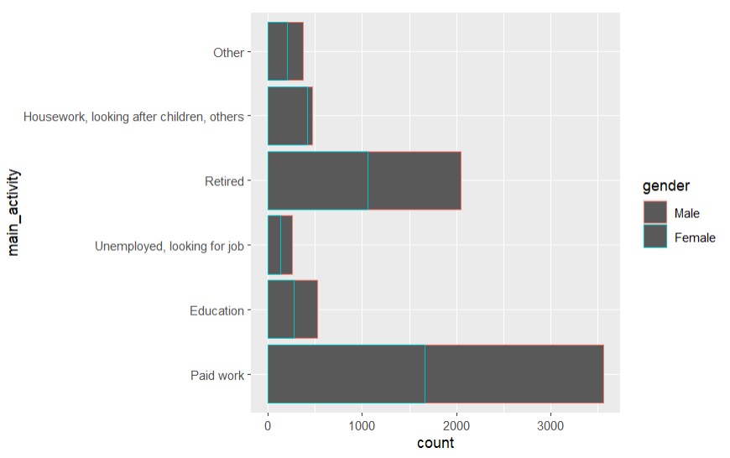
ggplot(ess_mini) +
geom_bar(aes(y = main_activity, color = gender))

Slide 47
ggplot(ess_mini) +
geom_bar(aes(y = main_activity, fill = gender))

Slide 48
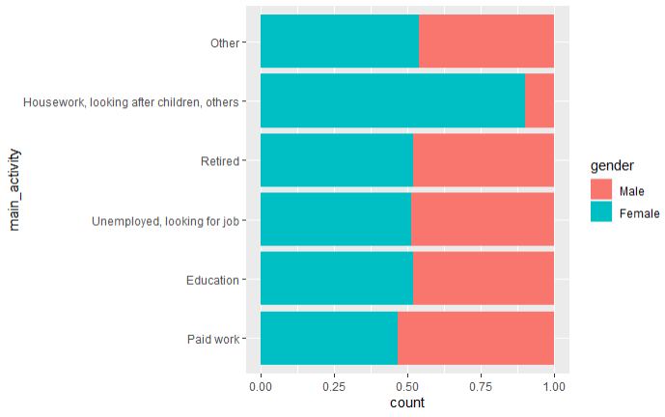
ggplot(ess_mini) +
geom_bar(aes(y = main_activity, fill = gender), position = "fill")

Slide 49
Quiz
What will this code do?
ggplot(ess_mini) +
geom_point(aes(height, weight)) +
geom_smooth(aes(height, weight))
49

Slide 50
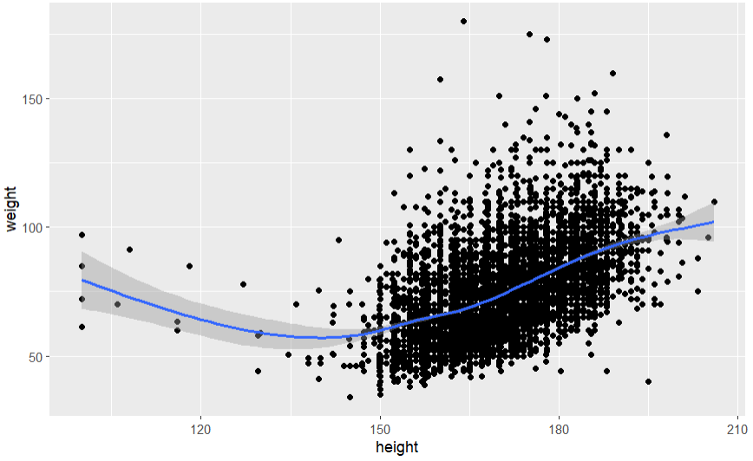
Each new geom adds a new layer
ggplot(ess_mini) +
geom_point(aes(height, weight)) +
geom_smooth(aes(height, weight))

Slide 51
Each new geom adds a new layer
ggplot(ess_mini) +
geom_point(aes(height, weight)) +
geom_smooth(aes(height, weight))
DRY – don’t repeat yourself!

Slide 52
global vs. local

Slide 53
ggplot(data = ess_mini, mapping = aes(height, weight)) +
geom_point() +
geom_smooth()
Mappings (and data) in ggplot() apply globally - to all layers

Slide 54
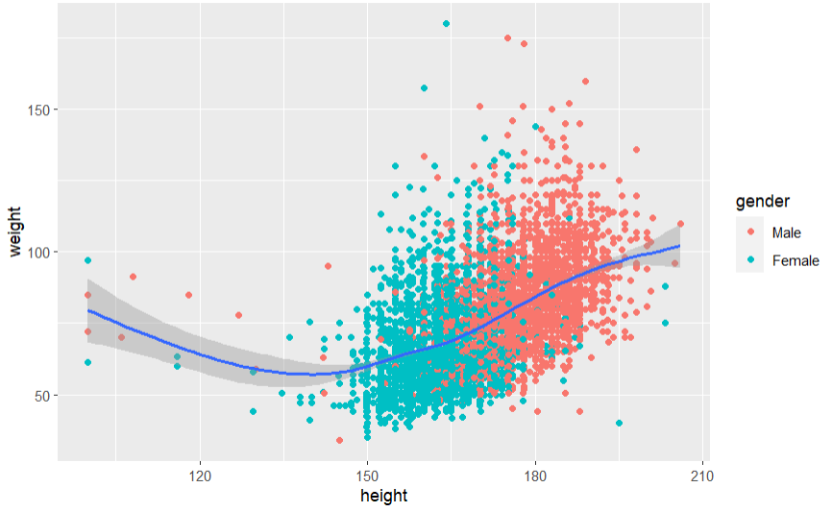
ggplot(data = ess_mini, mapping = aes(height, weight)) +
geom_point(aes(color = gender) +
geom_smooth()
geoms can contain additional mappings (or override globals)
Notes:
Individual geoms can also be based on different data – for example, to add specific summary statistics

Slide 55
Quiz
What is different about this plot? Run the code!
p <- ggplot(mpg) +
geom_point(aes(displ, hwy)) +
geom_smooth(aes(displ, hwy))
library(plotly)
ggplotly(p)
55

Slide 56
interactivity

Slide 57
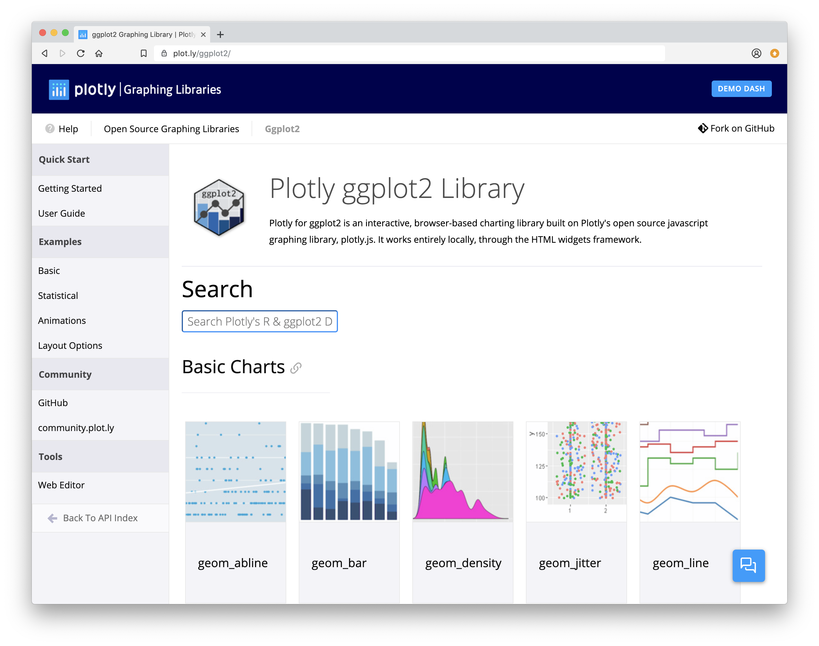
Plotly
Tools for making interactive plots. plot.ly/ggplot2/

Slide 58
Saving
graphs

Slide 59
Saving plots manually
In RMarkdown document, after running chunk
Right-click, Save As
Or click on Show in New Window on top right
Resize, then take a screenshot (e.g., Win + Shift + S)
When code is run in Console, plot shows in Viewer pane -> select Export

Slide 60
Saving plots with code
But where will
it save it?
ggsave() saves the last plot.
Uses size on screen:
ggsave("my-plot.pdf")
ggsave("my-plot.png")
Specify size
ggsave("my-plot.pdf", width = 12, height = 6, units = "cm")

Slide 61
Working directory
R associates itself with a folder (i.e. directory) on your computer.
This folder is known as your "working directory"
When you save files, R will save them here
When you load files, R will look for them here
You can change that (getwd(), setwd()) – BUT
→ Rmd files save / search in the folder they are in
→ RStudio Projects set the working directory to their main folder
61

Slide 62
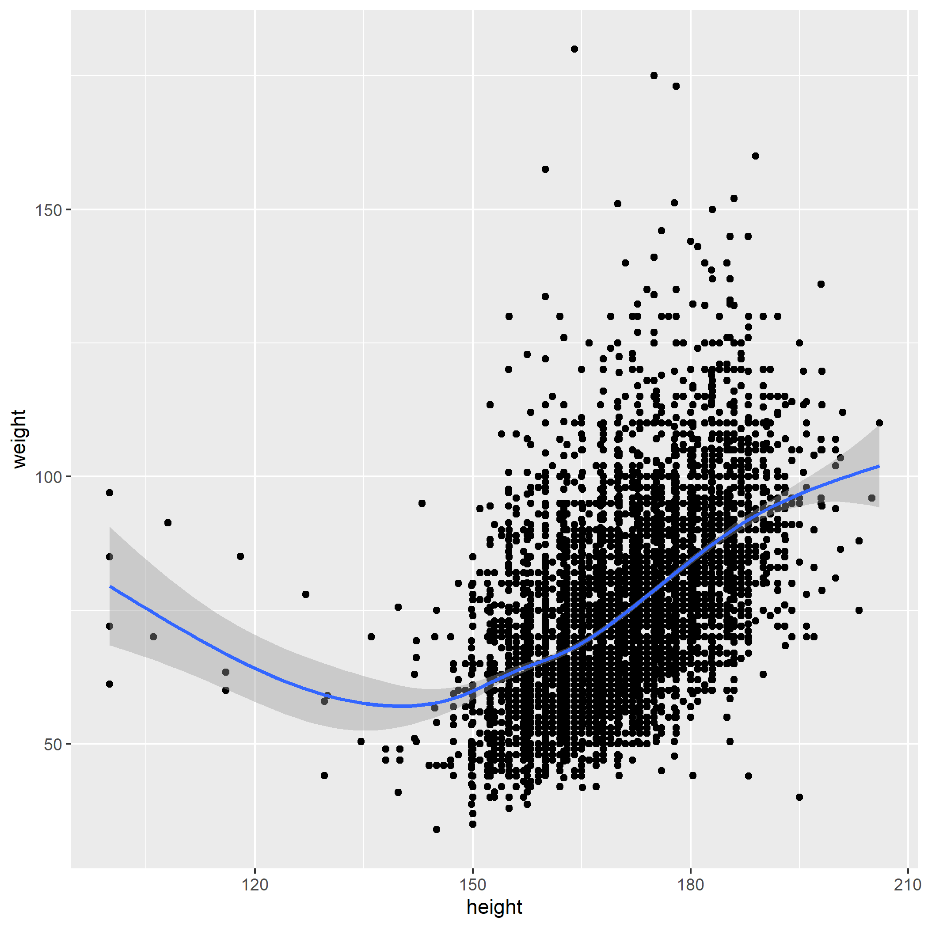

Your Turn 8
Save your last plot. Then locate it in your files pane and open it.

Slide 63
Grammar
of Graphics

Slide 64
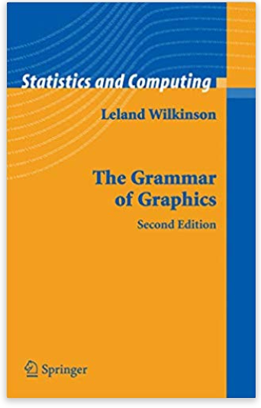
Grammar of graphics
Idea to break down plots into standardised parts
Each plays a specific role
Individual grammatical elements can easily be exchanged
“For a select few, it is a fascinating read” – but foundation of ggplot2

Slide 65
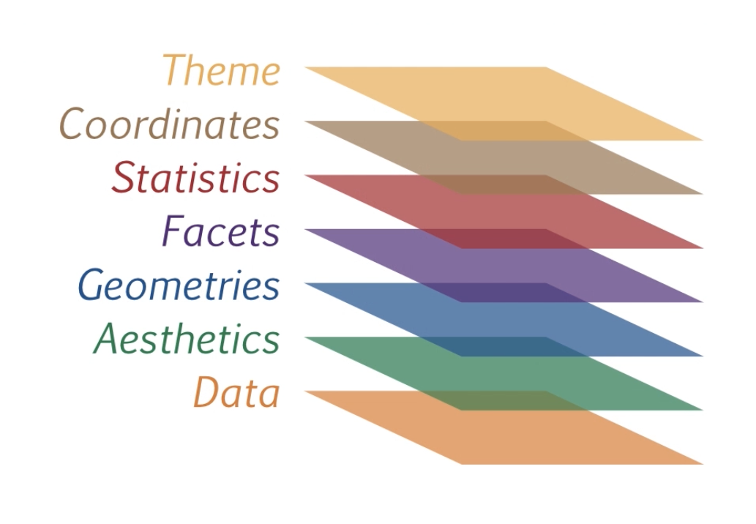
Elements of the grammar
Notes:
7 layers – so far, we have worked with the first 3 – will review that and then add a bit more

Slide 66
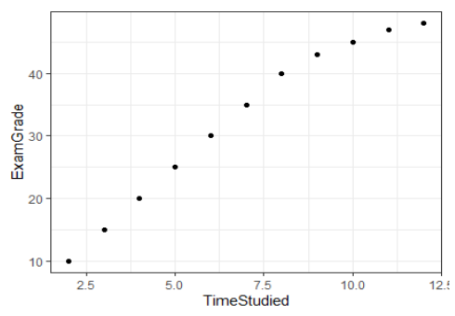
Basic ggplot2 plots
Always need Data, Aesthetics and Geometries
ggplot(examResults, aes(x=TimeStudies, y=ExamGrade))+ geom_point()

Slide 67
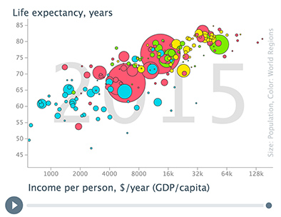
Adding complexity
Building the classic gapminder graph

Slide 69
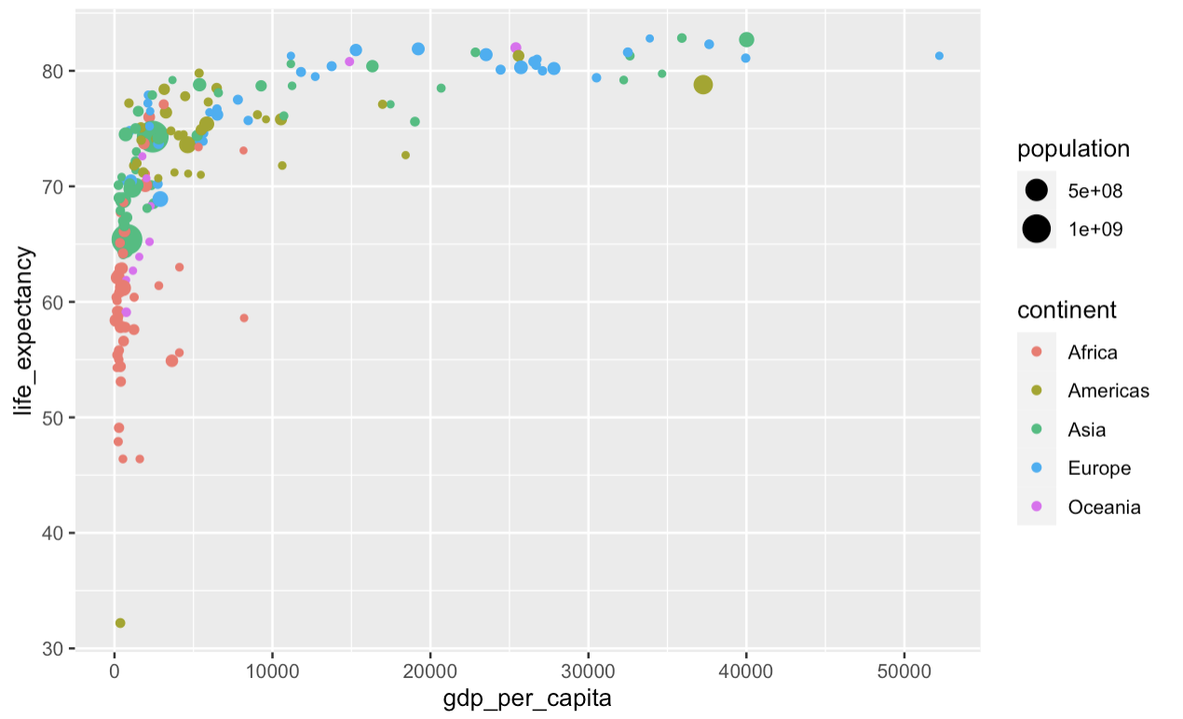
Starting out
ggplot(gapminder_2010, aes(x = gdp_per_capita, y = life_expectancy, color = continent, size = population))+ geom_point()
Notes:
They can have different aesthetics

Slide 70
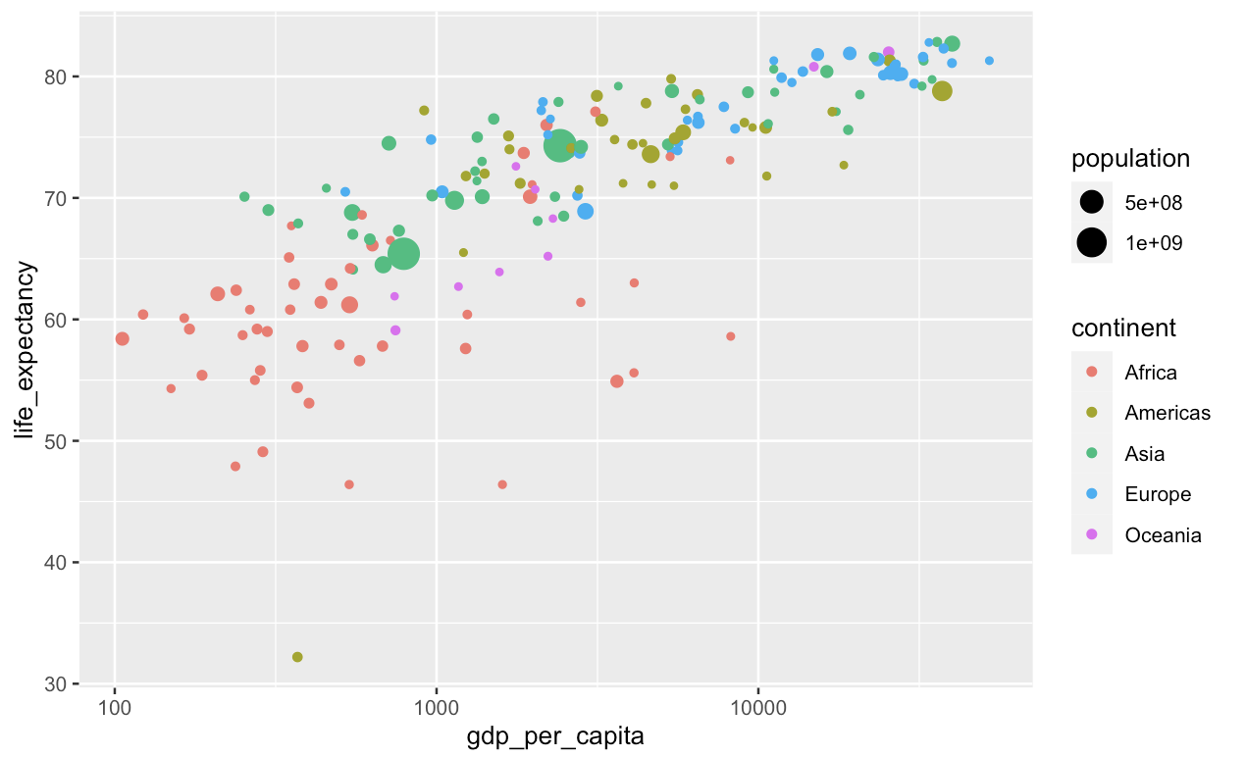
Changing coordinates
ggplot(gapminder_2010, aes(x = gdp_per_capita, y = life_expectancy, color = continent, size = population))+ geom_point() + scale_x_log10()
Notes:
They can have different aesthetics

Slide 71
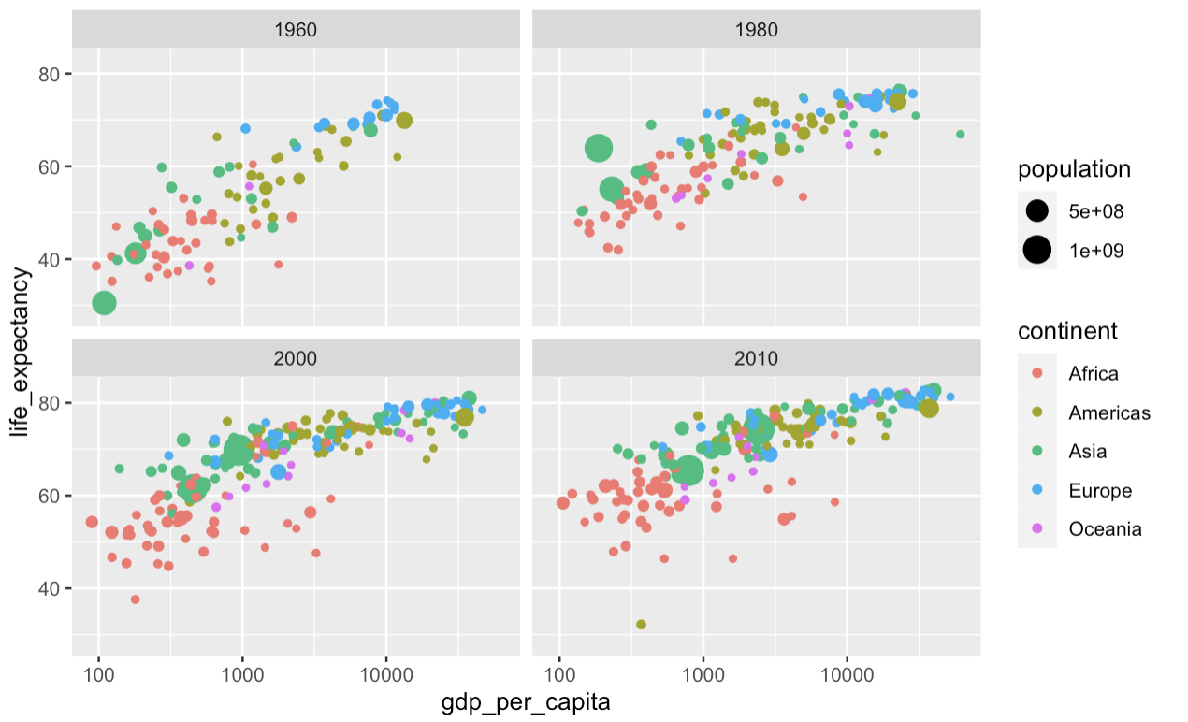
Adding facets
gapminder %>% filter(year %in% c(1960, 1980, 2000, 2010)) %>% ggplot(aes(x = gdp_per_capita, y = life_expectancy, color = continent, size = population))+ geom_point() + scale_x_log10() + facet_wrap (vars(year))
Notes:
They can have different aesthetics

Slide 72
Changing the theme
gapminder %>% filter(year %in% c(1960, 1980, 2000, 2010)) %>% ggplot(aes(x = gdp_per_capita, y = life_expectancy, color = continent, size = population))+ geom_point() + scale_x_log10() + facet_wrap(vars(year)) + jtools::theme_apa(legend.use.title = TRUE)
Notes:
They can have different aesthetics

Slide 73
Changing the theme
gapminder %>% filter(year %in% c(1960, 1980, 2000, 2010)) %>% ggplot(aes(x = gdp_per_capita, y = life_expectancy, color = continent, size = population))+ geom_point() + scale_x_log10() + facet_wrap(vars(year)) + jtools::theme_apa(legend.use.title = TRUE)+ labs(title = "The past 50 years: Greater wealth and greater health", x = "GDP per capita(USD/year)", y = "Life expectancy (years)”, color = "Continent", size = "Population")
Notes:
They can have different aesthetics

Slide 74
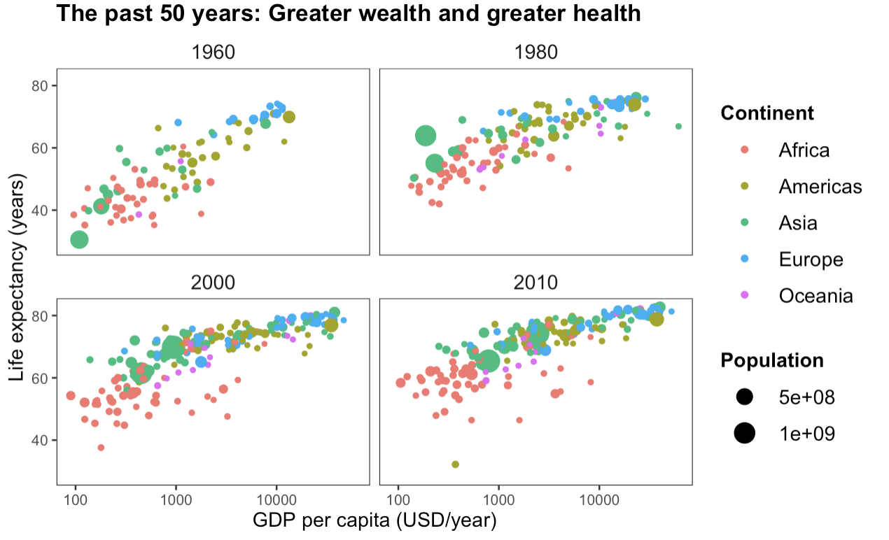
Changing the theme
Notes:
Quite a lot still to be done – but this covers the relevant elements of the grammar of graphics

Slide 75
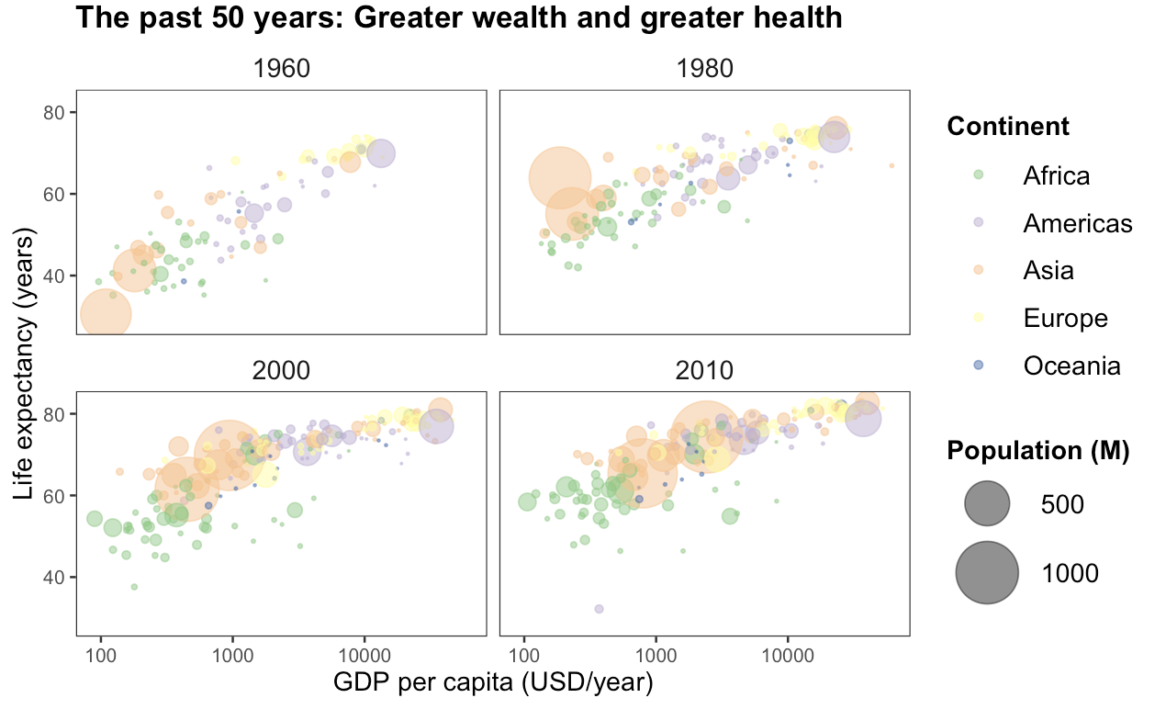
After a few more lines of code
Notes:
You have this at the bottom of your file

Slide 76
Elements of the grammar
Notes:
When thinking about graphs in terms of these elements, it becomes relatively easy to build them up step by step and to navigate the ggpplot2 documentation and cheatsheet

Slide 77
What else?

Slide 78
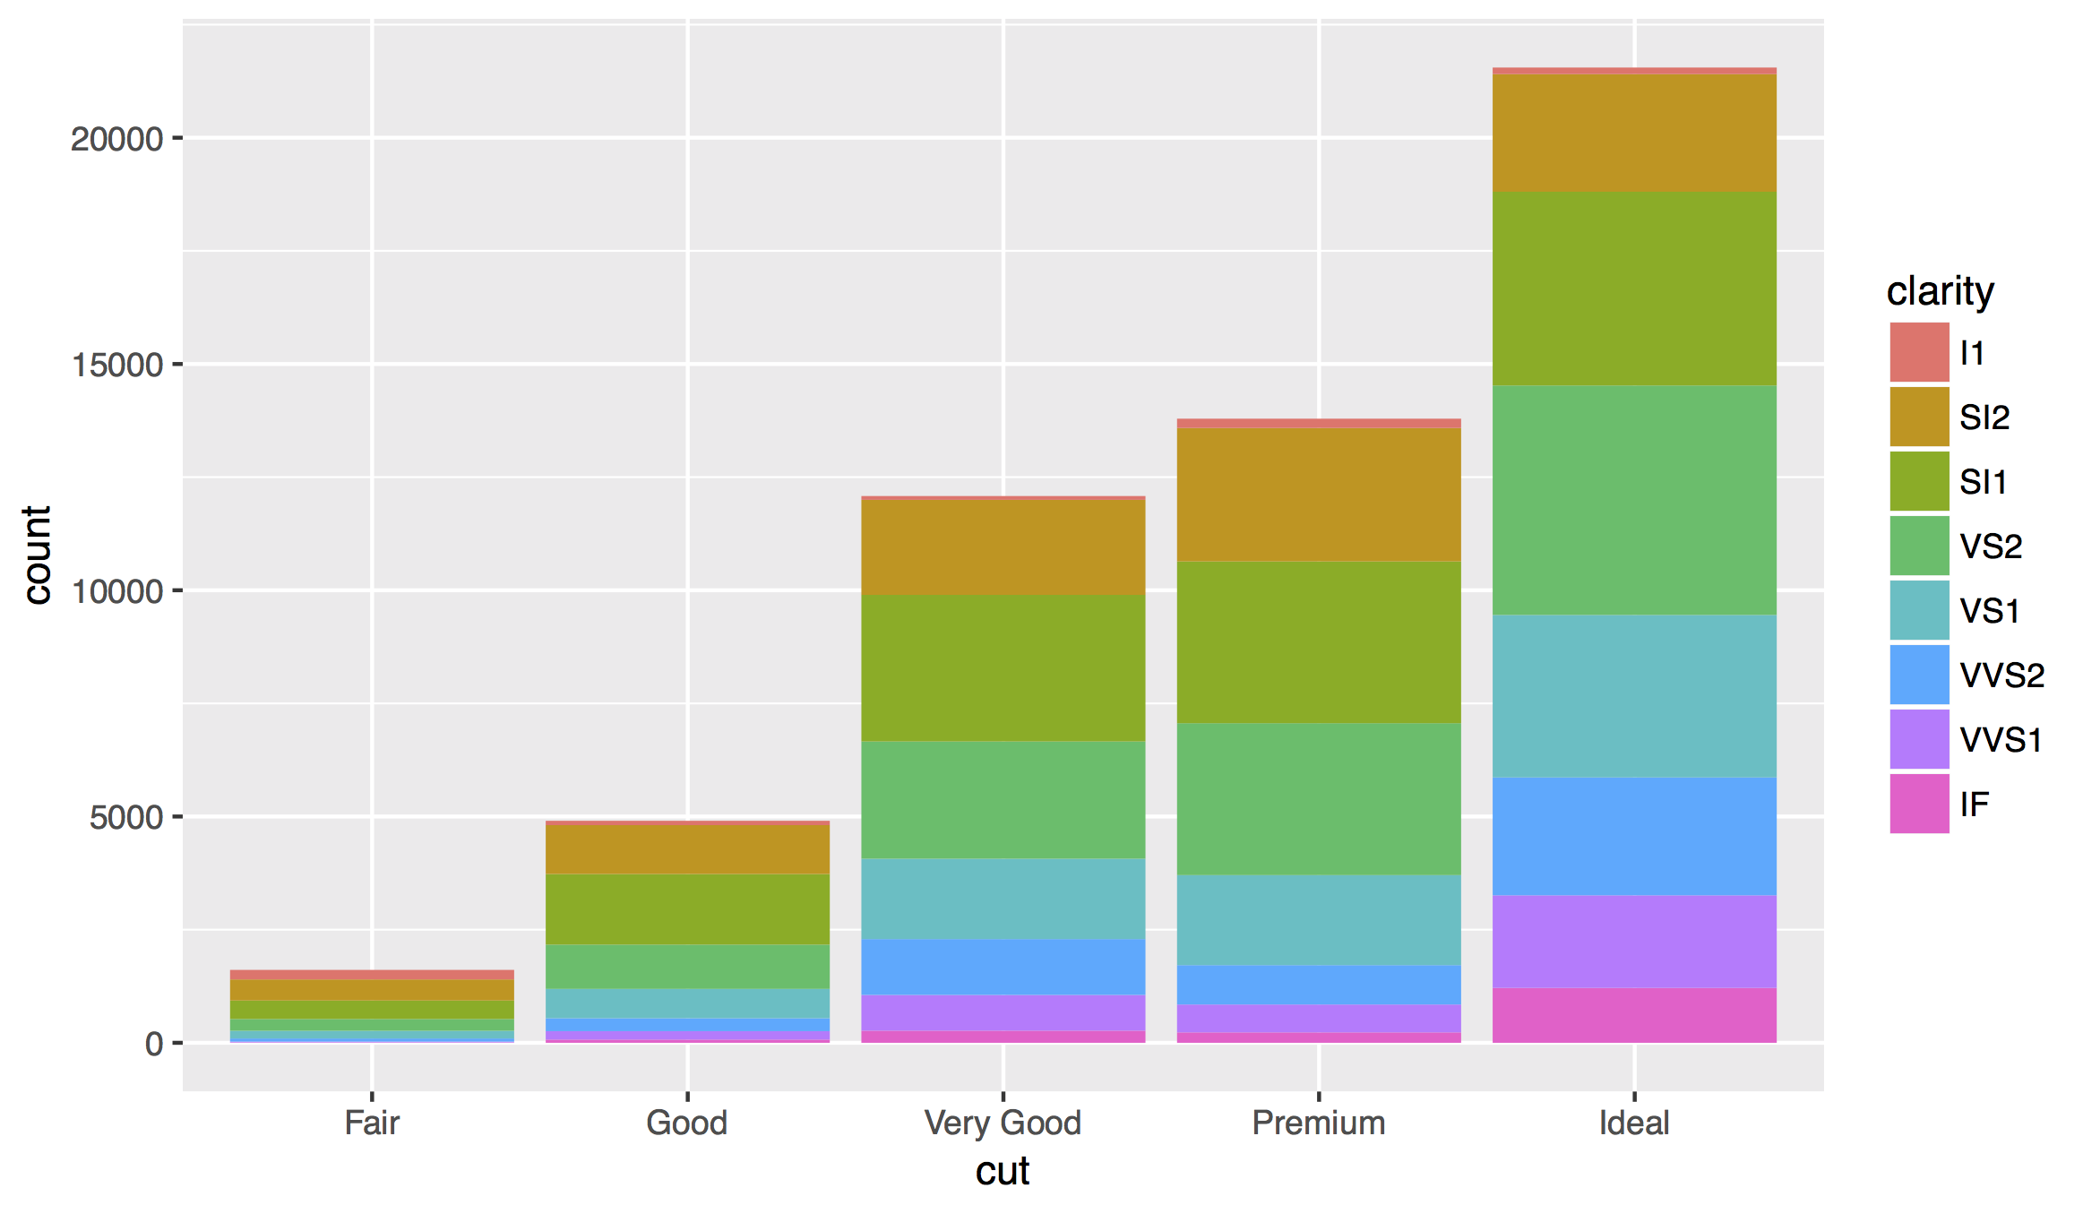

Slide 79
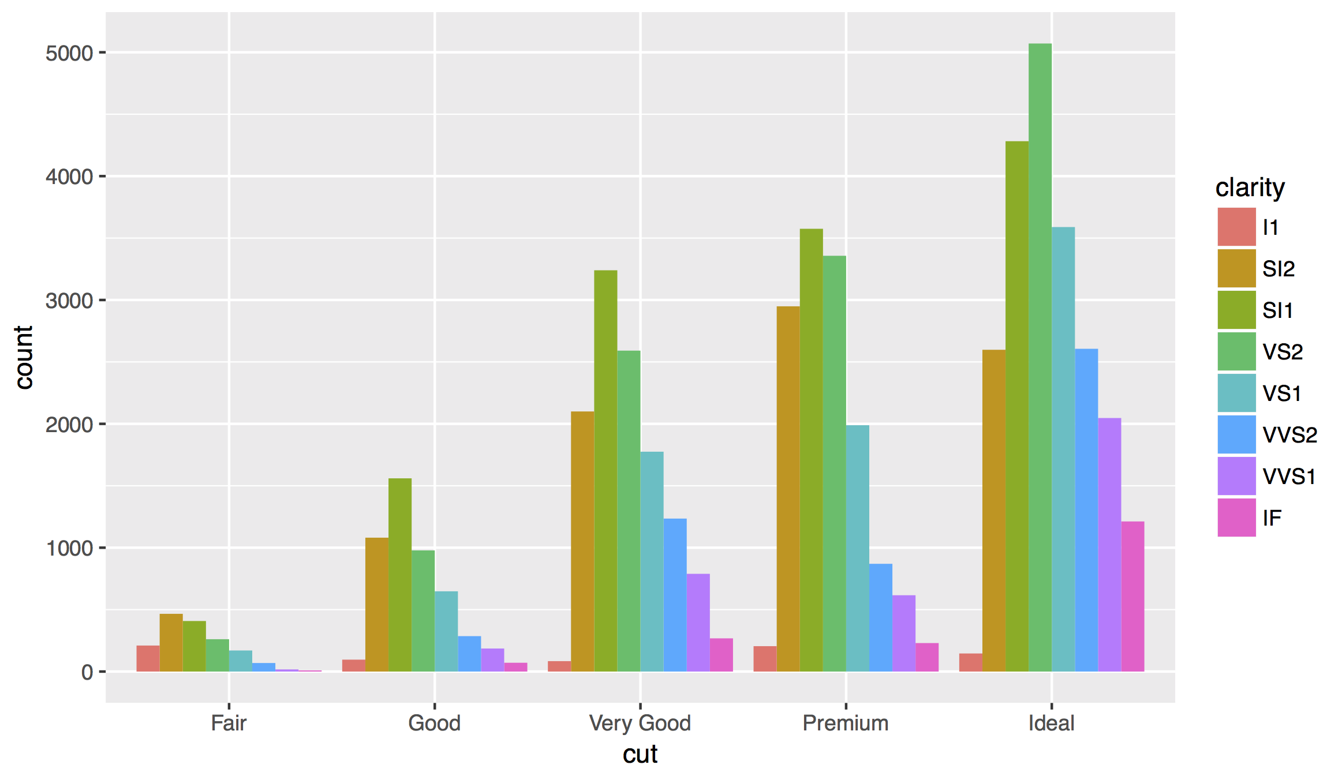
Position Adjustments
How overlapping objects are arranged

Slide 80
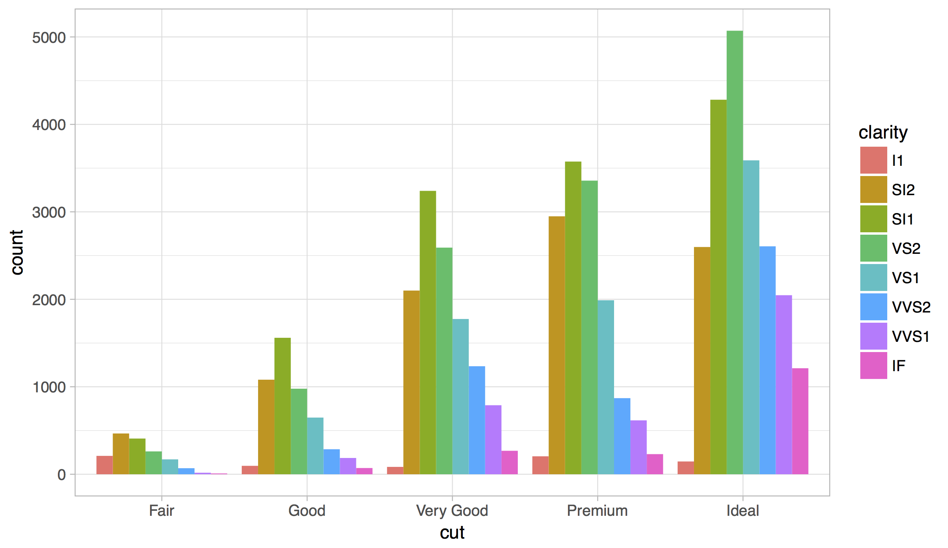
Themes
Visual appearance of non-data elements
+ jtools::theme_apa()

Slide 81
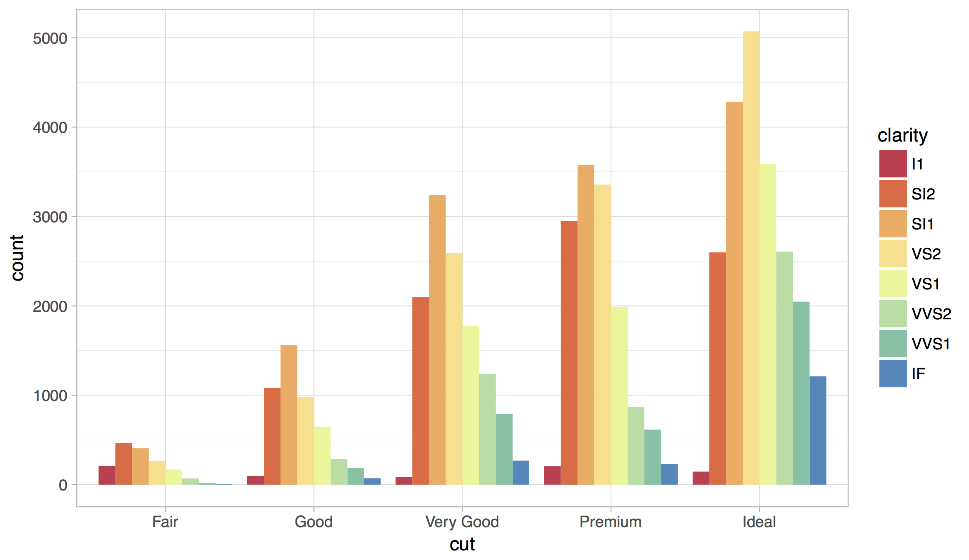
Scales
Customize color scales, other mappings
Notes:
Best with scale_color_brewer() and scale_fill_brewer()

Slide 82
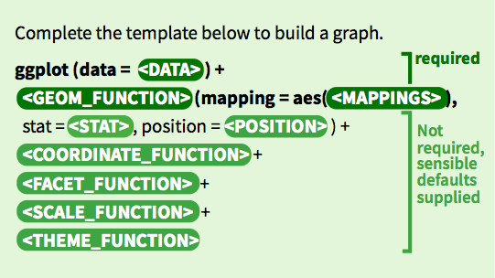
The full ggplot2 template
Make any plot by filling in the parameters of this template
82

Slide 83
James Cheshire, http://bit.ly/xqHhAs

Slide 84
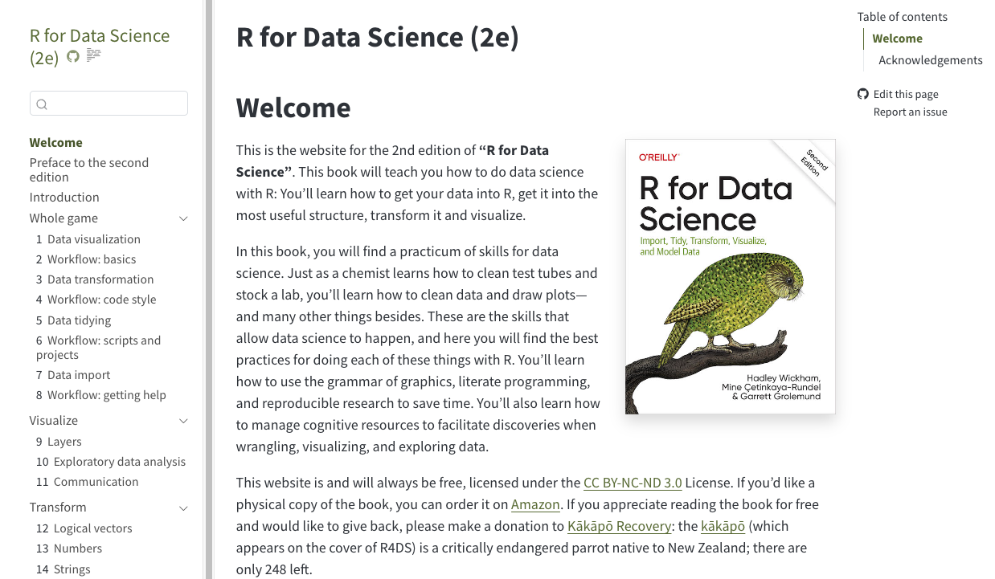

https://r4ds.hadley.nz/
Complete and free online
The ultimate resource for most of today

Slide 85
Your Turn
Open 03-Transform-Exercises.Rmd
85

Slide 86
Visualize Data with

